Slide 1
Decision Dashboard for Urban Food Production
CS896 / Capstone Project • Lokesh Das
Team 9
Venkata Subba Rao Are
Mallikarjun
Navya Boddupalli

Slide 2
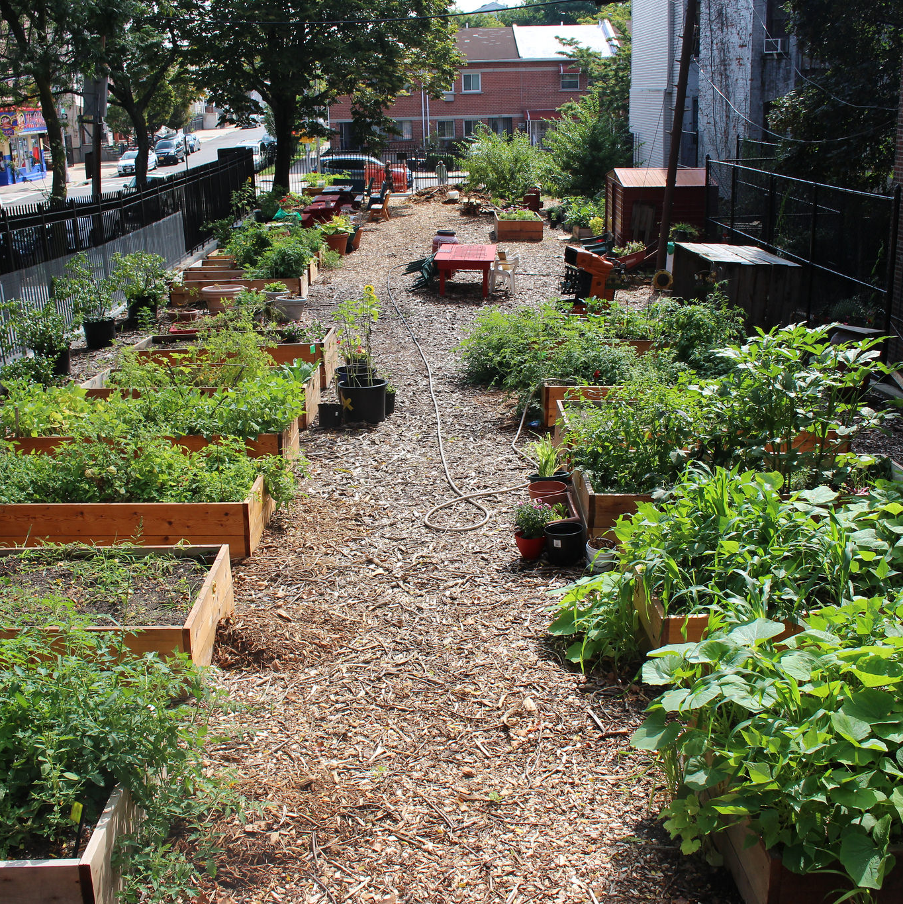
Project Background
Rising food insecurity in urban areas highlights the urgent need for local solutions.
Inequitable access to healthy food creates health disparities across different demographics.
Urban agriculture offers a pathway to improve access and optimize underutilized land.
This project provides a data-driven decision-support tool to empower planners in identifying optimal sites.

Slide 3
Project Objective
📍
Identify Suitable Land
Pinpoint specific land parcels that are optimal for urban food production.
📊
Integrate Multi-Source Data
Combine demographic, socioeconomic, health, and access metrics into one analysis.
🎯
Score Suitability
Develop and apply a parcel-level suitability score for precise evaluation.
🖥️
Develop Interactive Dashboard
Build a GIS-based tool to visualize data and support stakeholder decisions.

Slide 4
Datasets Used
📂 Provided Datasets
Census Tract Data (GIS-friendly)
Local Data for Better Health (tract & place-level)
Local Data for Better Health (Place Data)
ZCTA Data (GIS-friendly)

Slide 5
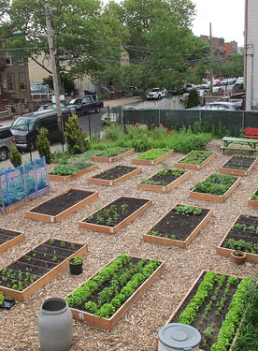
Key Variables
🩺 Health
Obesity rates
Diabetes prevalence
High blood pressure
👥 Demographics
Age distribution
Race & Ethnicity
Disability status
💰 Socioeconomic
Household Income
Poverty levels
SNAP participation
🏙️ Built Environment
Food access points
Public transit access
Vacant land parcels

Slide 6
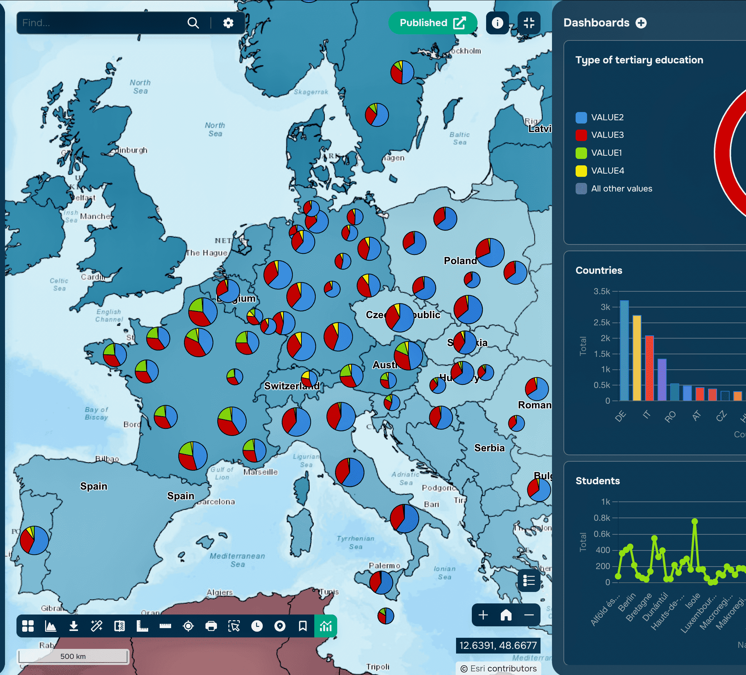
Methodology
1 Data Cleaning & Alignment
Standardize tract & parcel data
2 Normalization
Scale variables for comparison
3 MCDM Framework
Multi-Criteria Decision Making setup
4 AHP Weight Assignment
Assign importance weights analytically
5 Suitability Score
Final calculation per parcel

Slide 7
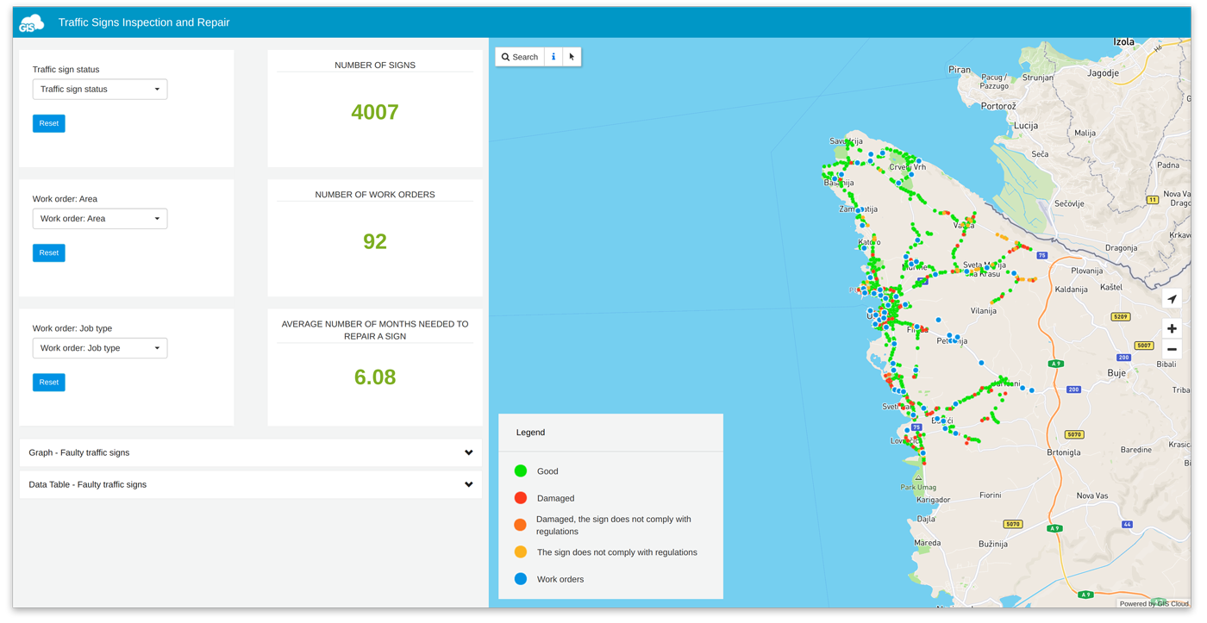
Tools and Technologies
🗺️
ArcGIS / Online
🐍
R / Python
🔍
Spatial Analysis
💻
Web Dashboard

Slide 8
8-Week Project Plan
Weeks 1–2
Understanding & Exploration
Scope definition & requirements
Initial data exploration
Weeks 3–4
Data Prep
Collection & preprocessing
Cleaning & integration
Weeks 5–6
Analysis
Exploratory spatial analysis
MCDM & AHP weighting
Score computation
Weeks 7–8
Finalization
Dashboard development
Testing & refinement
Final presentation

Slide 9

Expected Outcomes
Identification of high-suitability land parcels
Interactive GIS decision dashboard
Insights into food access and health inequities
Practical tool for planners and stakeholders
“Enabling data-informed, equitable urban food strategies.”

Slide 10
Thank You 😊

